Slide 1
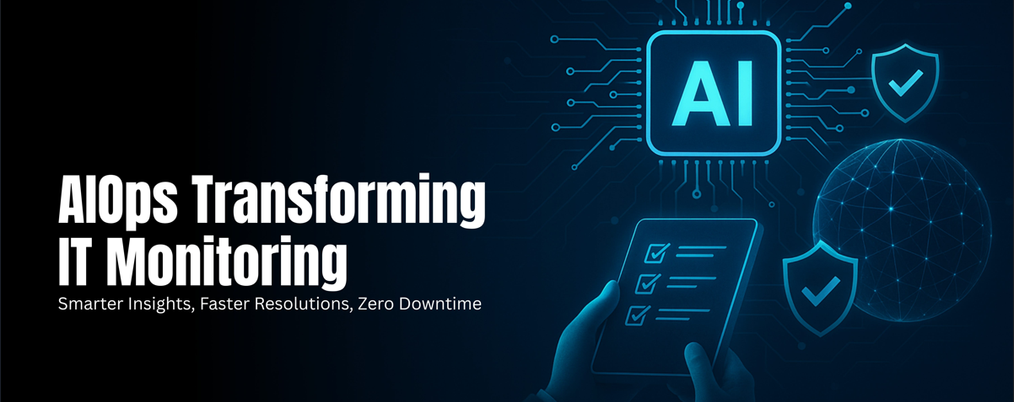
Implementing Intelligent Infrastructure Monitoring Platform with AIOps, Predictive Maintenance, and Automated Remediation for Hybrid Cloud Environments
Presenters:
Hamza Raja
Diploma in AIOPS
EduQual Level 6

Slide 2
Project Overview
What is Intelligent Monitoring
01
02
TABLE OF CONTENTS
Problem Statement & Proposed Solution
Core AIOps Platform Capabilities
03
04
AIOps Architecture & Implementation
Q/A
05
06

Slide 3
01
Project Overview

Slide 4

Project Goal
Proactive Monitoring Enablement
Establish real-time tracking of hybrid cloud infrastructure metrics to detect anomalies before they impact operations, ensuring continuous system visibility.
Intelligent Alerting System
Implement AI-driven alerting mechanisms to highlight prioritize critical issues, reducing false positives and enabling rapid response to potential threats.

Slide 5
Project Goal
Predictive Maintenance Integration
Integrate predictive analytics to forecast infrastructure failures, allowing proactive maintenance and minimizing unplanned downtime.
Automated Problem Resolution
Implement automated remediation workflows to resolve common infrastructure issues without manual intervention
Performance & Availability Optimization
By predicting issues early and fixing them automatically, the platform reduces manual work, improves system reliability, and help with continuously monitors SLA compliance.

Slide 6
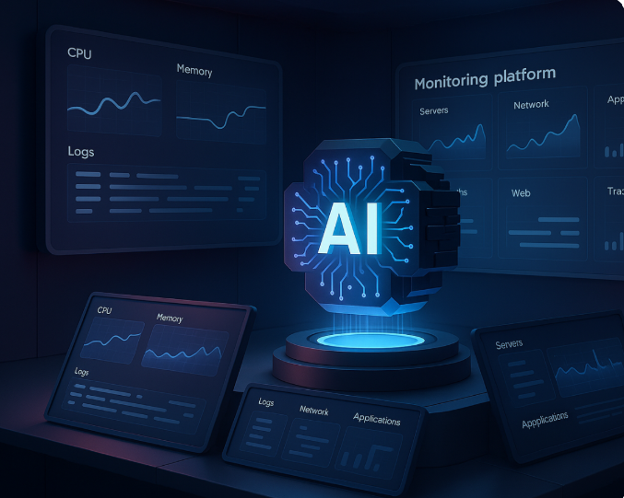
02 What is Intelligent Infrastructure Monitoring?
Intelligent infrastructure monitoring is the process of continuously collecting, analyzing, and interpreting telemetry data (such as metrics, logs, and traces) from IT systems including servers, networks, databases, and cloud services to not only monitor real-time health but also to proactively predict potential failures and automate troubleshooting.

Slide 7
03 Problem Statement & Proposed Solution
Problem Statement
In modern IT environments, infrastructure is distributed across on-premises systems, cloud platforms, and container-based workloads. Traditional monitoring tools operate in isolation and mostly react after issues occur. This leads to too many alerts, slower problem detection, and time-consuming manual troubleshooting. As a result, organizations experience more downtime, missed SLAs, and reduced operational efficiency.
Solution
To address these challenges, this project introduces a unified monitoring platform. It brings together metrics, logs, and traces from hybrid environments and analyzes them to identify issues early. By predicting problems and fixing them automatically, the platform reduces manual work, improves system reliability, and continuously monitors SLA compliance.

Slide 8
04 Core AIOps Platform Capabilities
01
Full-Stack Observability
Automation Capabilities
03
Unify data collection across applications, networks, and cloud resources to provide end-to-end visibility into hybrid infrastructure performance.
Implement automation tools to automate routine tasks such as alert triage and issue resolution, reducing manual effort and improving mean time to response (MTTR)
02
Machine Learning Integration
04
Unified AIOps Platform
Implement ML algorithms to analyze infrastructure data, enabling pattern recognition and intelligent decision-making for the AIOps platform.
Combine intelligent monitoring, predictive maintenance, and automated remediation into a single AIOps platform, improve infrastructure management efficiency.

Slide 9
AIOps Architecture & Implementation
05

Slide 10
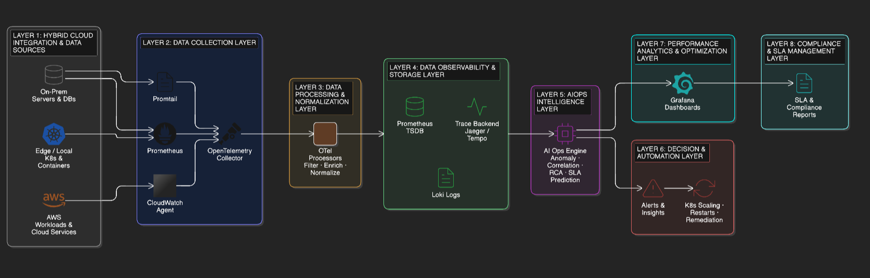
AIOps Architecture for Intelligent Monitoring

Slide 11
Layer 1: Hybrid Cloud Integration & Data Sources
Unified Monitoring Across On-Premises, Cloud & Edge
Deploy unified monitoring across on-premises infrastructure, cloud platforms, and edge/Kubernetes environments, ensuring consistent visibility and centralized oversight of distributed hybrid systems that generate metrics, logs, and traces.
Multi-Cloud Observability with Consistent Metrics
Implement multi-cloud observability at the data source level using standardized telemetry formats, enabling consistent metrics and alerting frameworks across diverse cloud and on-prem environments.

Slide 12
Layer 2: Data Collection Layer
Standardized Data Collection
Deploy data collection mechanisms using AWS CloudWatch Agent, Prometheus, Promtail, and OpenTelemetry Collector to gather metrics, logs, and traces from all hybrid environments in a consistent and vendor neutral manner.
Unified Data Ingestion Across Hybrid Platforms
Ensure all telemetry data from on-prem, cloud, and edge environments is ingested into a centralized observability pipeline for further processing and analysis.

Slide 13
Layer 3: Data Processing & Normalization Layer
Data Processing and Noise Reduction
Process collected data using OpenTelemetry processors to filter noise, enrich data with metadata, and normalize formats to ensure high-quality input for intelligent analysis.
Data Preparation for Correlation and Analysis
Prepare normalized telemetry data for correlation across metrics, logs, and traces, enabling accurate
downstream AIOps analysis.

Slide 14
Layer 4: Data Observability & Storage Layer
Metrics, Logs, and Traces Storage
Store processed data in specialized observability backends, including Prometheus for metrics, Loki for logs, and distributed tracing backends(Tempo) for traces.
Historical Visibility and Audit Evidence
Maintain historical data to enable trend analysis, monitor SLA compliance, generate reports, and provide a complete audit trail

Slide 15
Layer 5: AIOps Intelligence Layer
ML Models for Anomaly Detection & Pattern Recognition
Implement machine learning models within the AIOps intelligence layer to automatically detect anomalies and recognize patterns in infrastructure metrics and logs
Automated Root Cause Analysis with Correlation Algorithms
Implement automated root cause analysis using correlation algorithms and dependency awareness to associate performance degradation with underlying infrastructure or application components.
Intelligent Alerting with Noise Reduction
Configure intelligent alerting based on trend analysis and correlation rather than isolated threshold breaches, reducing alert noise and improving incident prioritization.

Slide 16
Layer 6: Decision & Automation Layer
Automated Remediation Workflows for Common Issues
Deploy automated remediation workflows triggered by AIOps engine to resolve common infrastructure issues such as service restarts, scaling operations, or configuration adjustments.
Self-Healing with Rollback & Safety Mechanisms
Implement self-healing capabilities using runbooks ,Kubernetes-native restart and rollback mechanisms, ensuring safe recovery and operational stability with minimal manual intervention.

Slide 17
Layer 7: Performance Analytics & Optimization Layer
APM Integration for Full-Stack Visibility
Deploy application performance monitoring (APM) integration using OpenTelemetry, providing full-stack visibility by correlating application performance with underlying infrastructure metrics.
Infrastructure Performance Analysis & Bottleneck Identification
Monitor infrastructure to detect bottlenecks in resources, latency, and workload distribution that reduce system efficiency.

Slide 18
Layer 8: Compliance & SLA Management Layer
Automated SLA Monitoring
Deploy automated SLA monitoring mechanisms to track service performance against defined SLAs, with centralized dashboards providing continuous compliance visibility.
Performance Baseline Establishment & Drift Detection
Establish performance baselines using historical telemetry data and detect performance drift to identify potential SLA or compliance risks at an early stage.

Slide 19
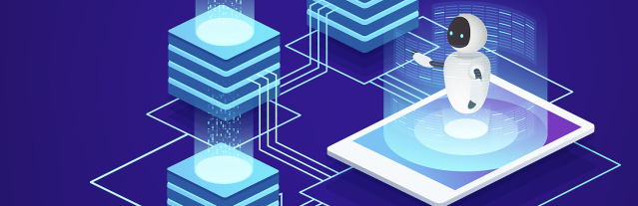
Compliance & SLA Management
Automated Compliance Validation & Audit Trail Management
Configure automated compliance validation processes and audit trail management to maintain regulatory compliance and support audit requirements.

Slide 20

Thank You Q&A

